Slide 1
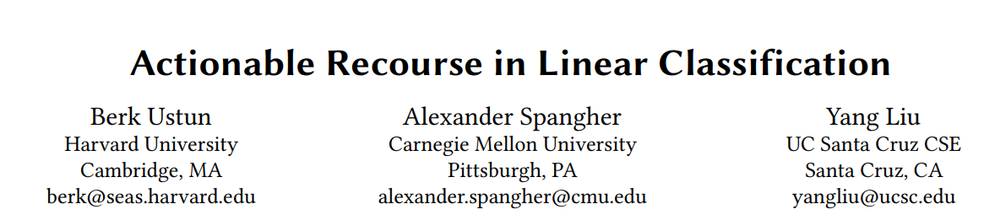
Presenter: Shuang Wang

Slide 2
Content
Introduction
Problem Statement
Integer Programming Tools
Demonstration
Conclusion

Slide 3
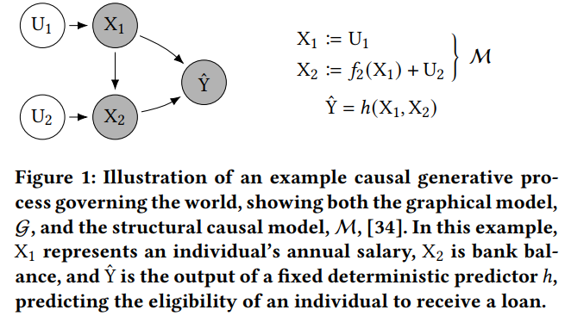
Introduction
The definition of Recourse:
The ability of a person to obtain a desired outcome from a fixed model.
Example 1:
an individual has been denied a loan and seeks an explanation and recommendation on how to proceed.
This individual has
an annual salary (X₁) of $75, 000
an account balance (X₂) of $25, 000
and the predictor ℎ = sign(X₁+5·X₂−$225, 000)
Approach ->
an annual salary of $100, 000 (+%33)
or
a bank balance of $30, 000 (+%20),
Karimi, Amir-Hossein, Bernhard Schölkopf, and Isabel Valera. "Algorithmic recourse: from counterfactual explanations to interventions." Proceedings of the 2021 ACM conference on fairness, accountability, and transparency. 2021.

Slide 4
Introduction
• The lack of recourse is often mentioned in calls for increased transparency and explainability in algorithmic decision-making
• Choice of Features: A model could use features that are immutable (e.g., age ≥ 50), conditionally immutable (e.g., has_phd, which can only change from FALSE → TRUE), or should not be considered actionable (e.g., married).
• Out-of-Sample Deployment: The ability of a model to provide recourse may depend on a feature that is missing, immutable, or adversely distributed in the deployment population.
• Choice of Operating Point: A probabilistic classifier may provide recourse at a given threshold (e.g., yˆi = 1 if predicted risk of default ≥ 50%) but fail to provide recourse at a more stringent threshold (e.g., yˆi = 1 if predicted risk of default ≥ 80%).
• Drastic Changes: A model could provide recourse to all individuals but require some individuals to make drastic changes (e.g., increase income from $50K → $1M).

Slide 5
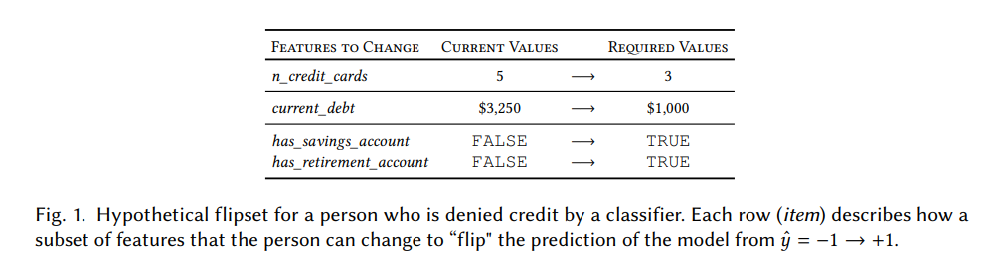
Introduction
To evaluate recourse for linear classification models, such as logistic regression models
To ensure recourse without interfering in model development
Aiming to answer questions such as:
• Will a model provide recourse to all its decision subjects?
• How does the difficulty of recourse vary in a population of interest?
• What can a person change to obtain a desired prediction from a particular model?

Slide 6
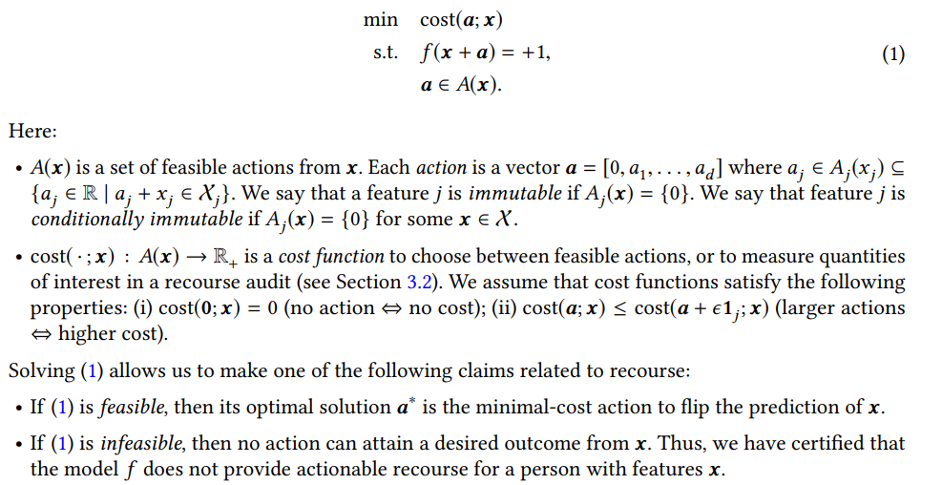
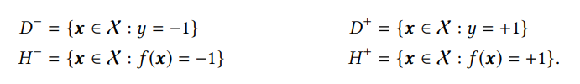
Problem Statement – Optimization Framework
Given a person who is assigned an undesirable outcome f (x) = −1, we aim to find an action a such that f (x + a) = +1 by solving an optimization problem of the form

Slide 7
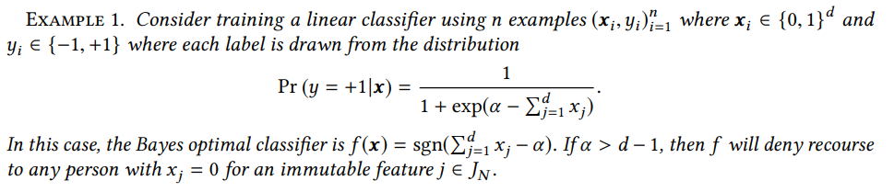
Problem Statement – Feasibility Guarantees
A simple sufficient condition for a linear classifier to provide a universal recourse guarantee
Remark 1. A linear classifier provides recourse to all individuals if it only uses actionable features and does not predict a single class.
Remark 2. If all features are unbounded, then a linear classifier with at least one actionable feature provides recourse to all individuals.
Remark 3. If all features are bounded, then a linear classifier with at least one immutable feature may deny recourse to some individuals

Slide 8
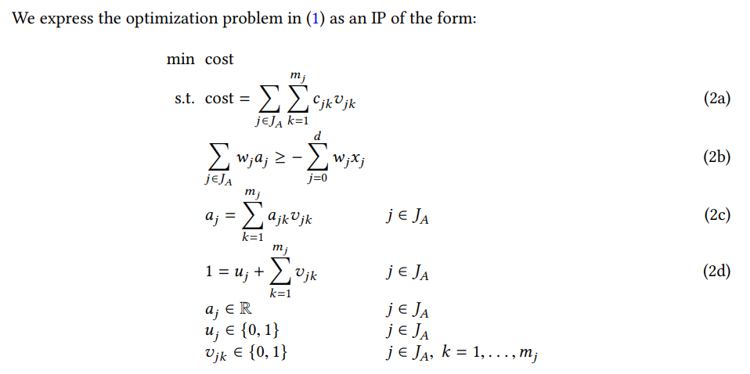
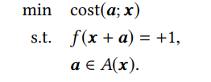
Integer Programming Tools – IP Formulation

Slide 9
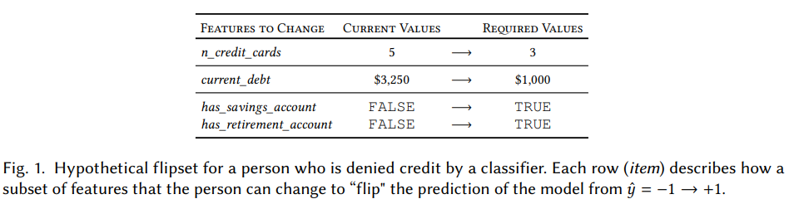
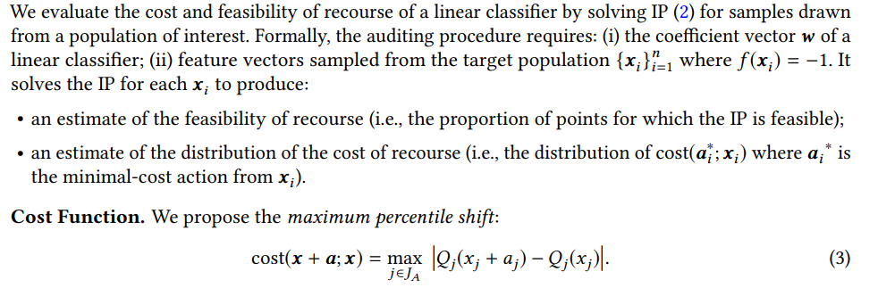
Integer Programming Tools – Auditing Recourse

Slide 10
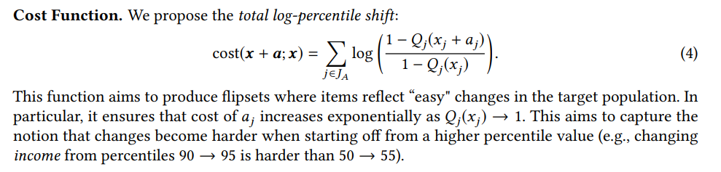
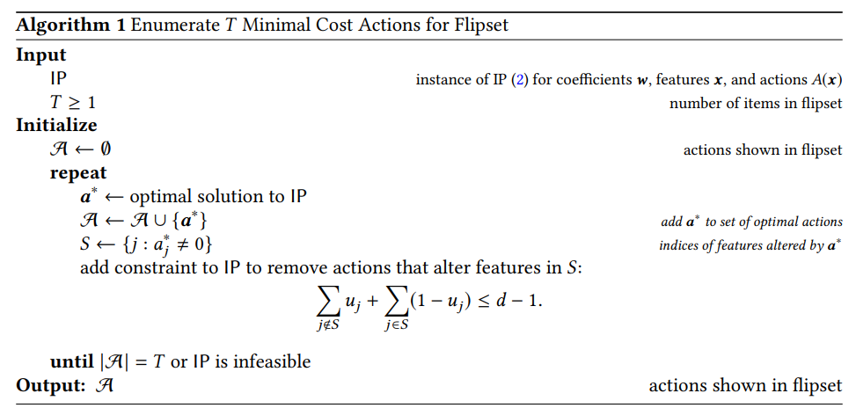
Integer Programming Tools – Building Flipsets

Slide 11
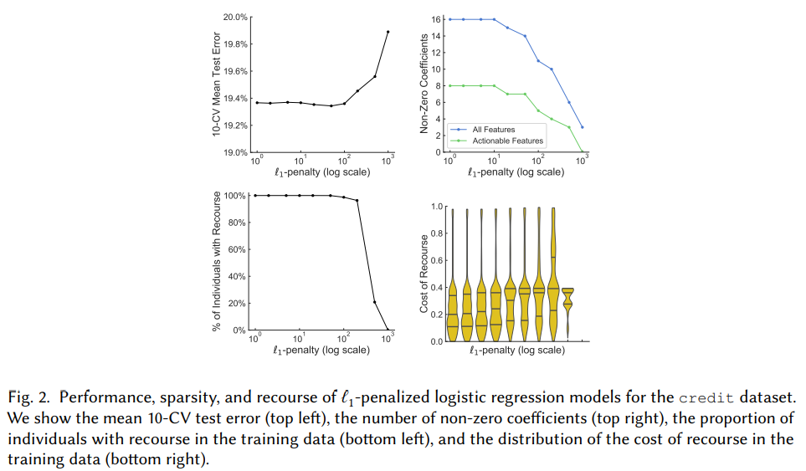
Demonstration

Slide 12
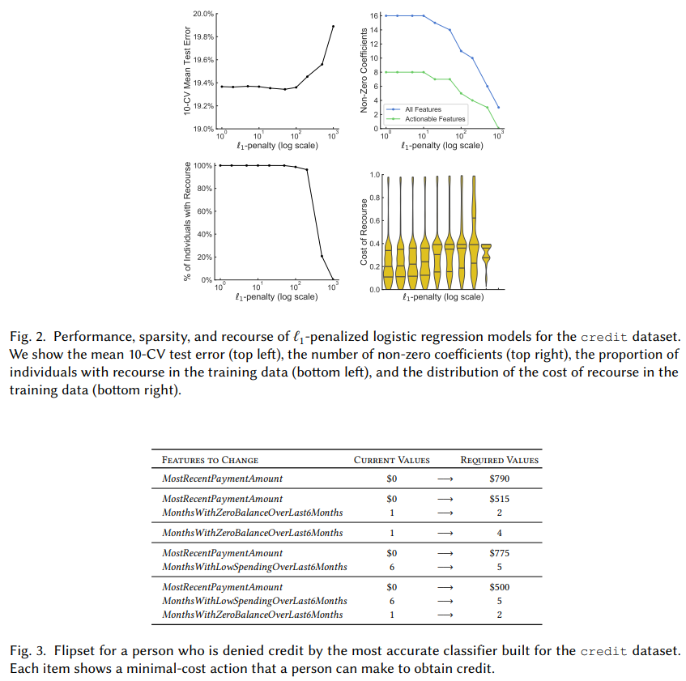
Demonstration

Slide 13
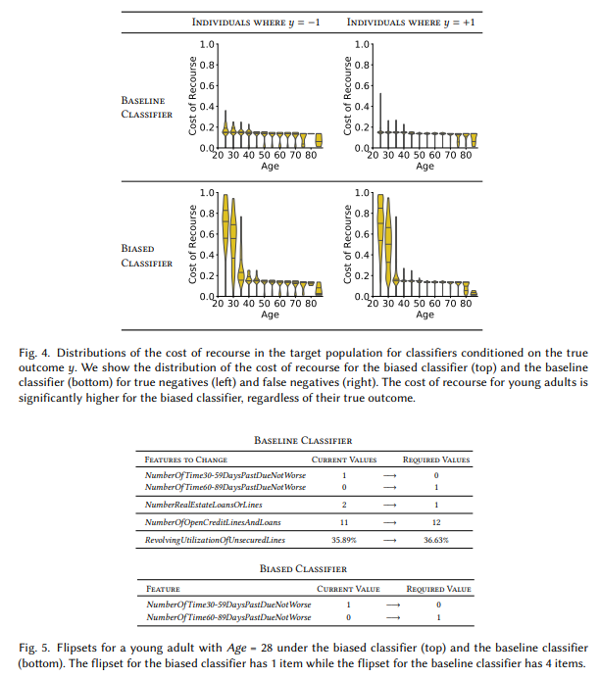
Demonstration

Slide 14
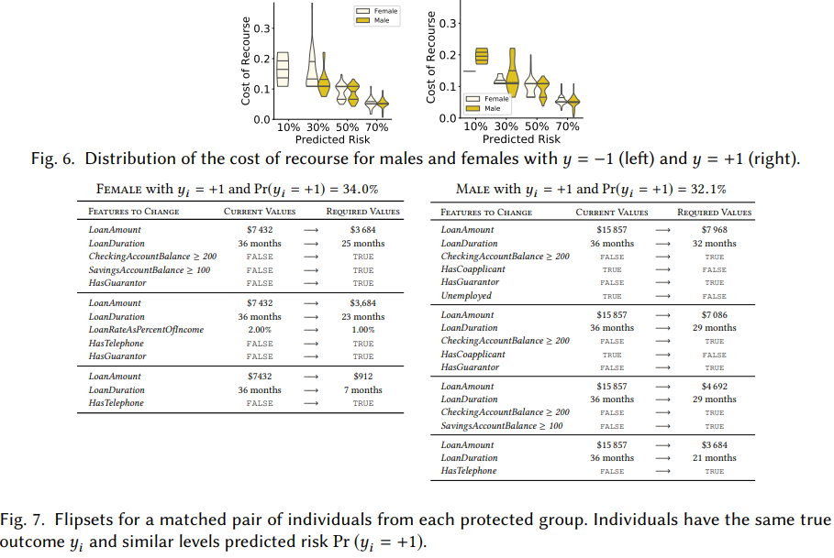
Demonstration

Slide 15
Conclusion
Extending our tools to evaluate recourse for non-linear classifiers.
Considering the causal relation between the features. For example, one could price incentives in a target population by comparing the cost of recourse for actions that alter (i) only causal features, and (ii) causal features and at least one ancillary feature.
Enumerating the complete set of minimal-cost actions for a person by using the procedure in Algorithm 1 to list actions until the IP become infeasible.
The flipsets in this paper are “abridged" in that they do not reveal all features of the model.
Model owners may not be willing to provide consumers with flipsets due to the potential for model theft.

Slide 16
Thank you!

